Slide 1
Body Performance
Ryan Huang

Slide 2
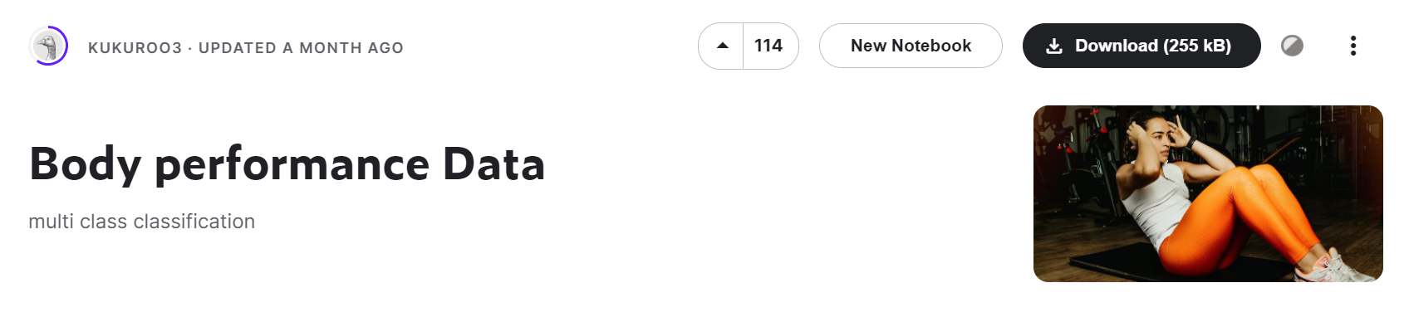
Data
A dataset from kaggle.com
Data shape(row data = 13393, features = 12)
Features: Age, gender, height_cm, weight_kg, body fat_%, disatolic(blood pressure), systolic(blood pressure), gripforce, sit and band forward_cm, sit-ups counts, broad jump_cm
Class: A, B, C, D (A is the best)

Slide 3
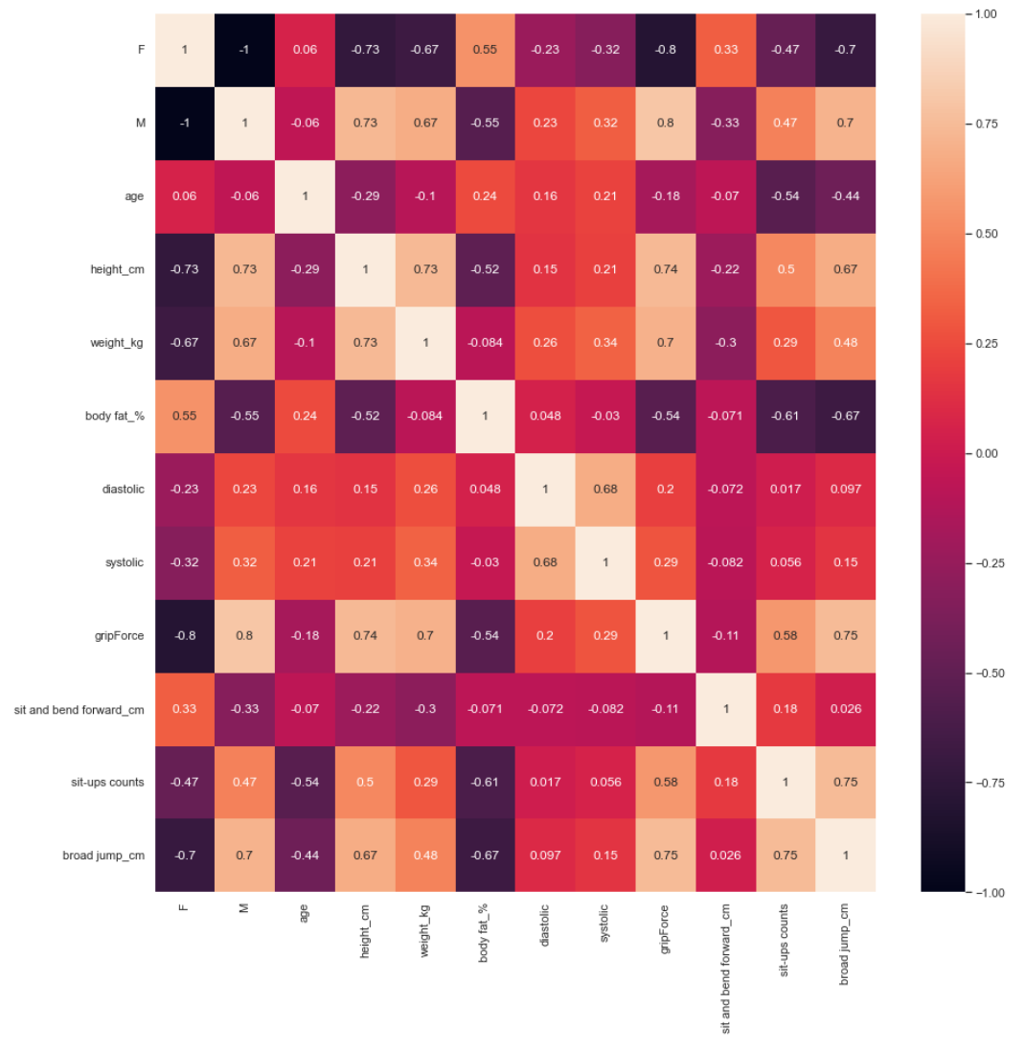
Feature Engineer
There is no missing data
Pd.get_dummies() to "vectorize" the 'gender'
Standardize the data
Data.corr() with performance in heatmap
There are few features have higher correlation
按一下以新增字

Slide 4
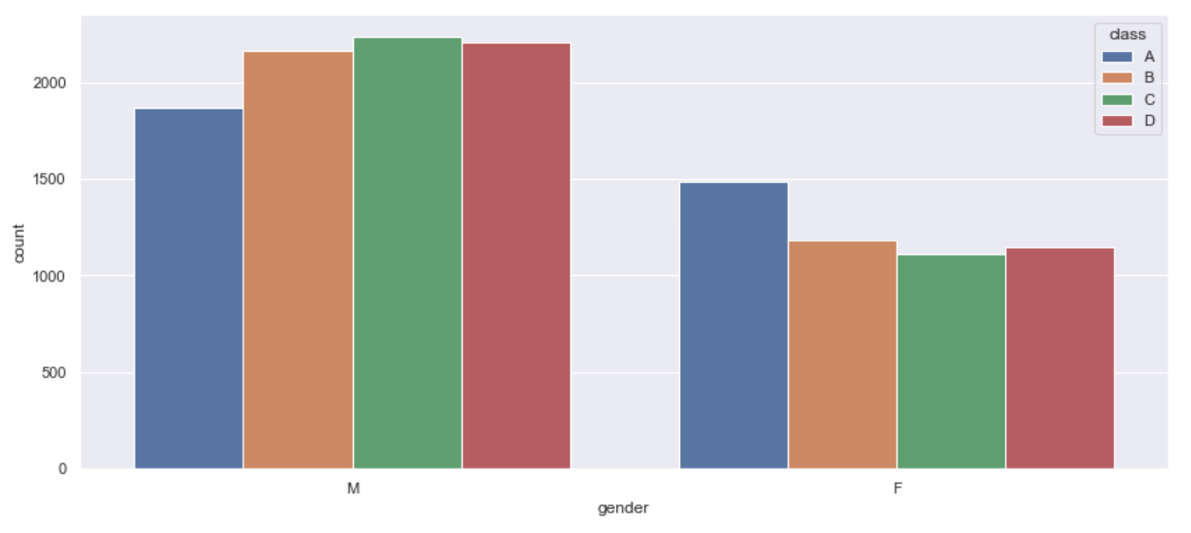
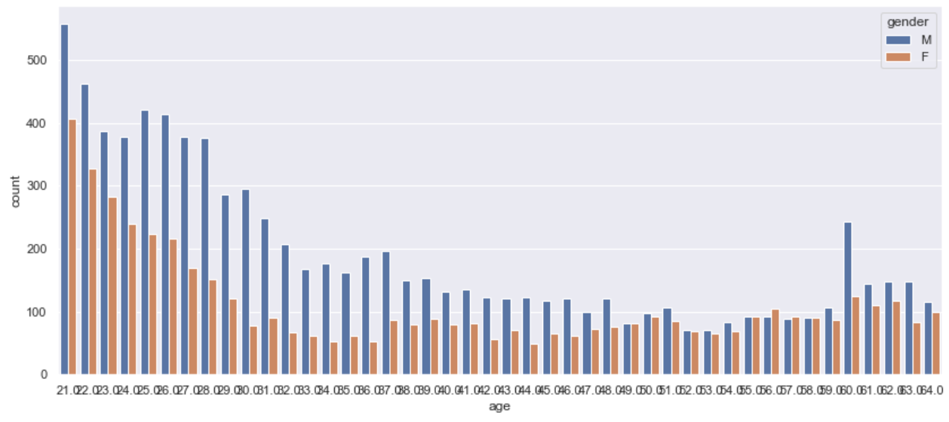
Distribution---gender and age
Male is more than Female, but the proportion of class A of female are more than male's.
Young people are more than old people.

Slide 5
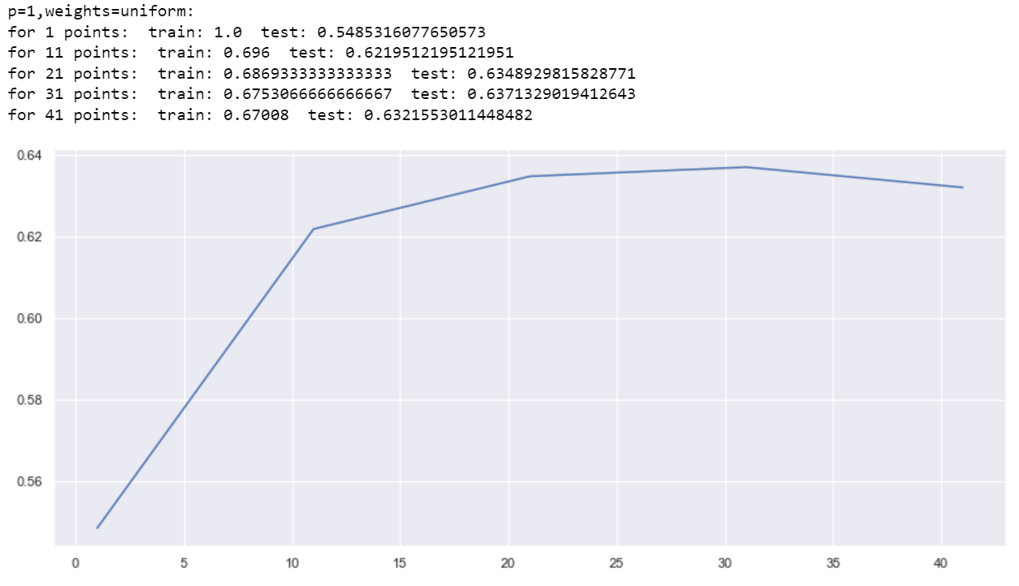
Model---KNN
KNN model: consider the closet points' class to determine the class
Distance type:
P=1 -->manhattan_distance
P=2 -->euclidean_distance
Weitht type: Uniform and Distance
Point number: 31 points perform the best

Slide 6
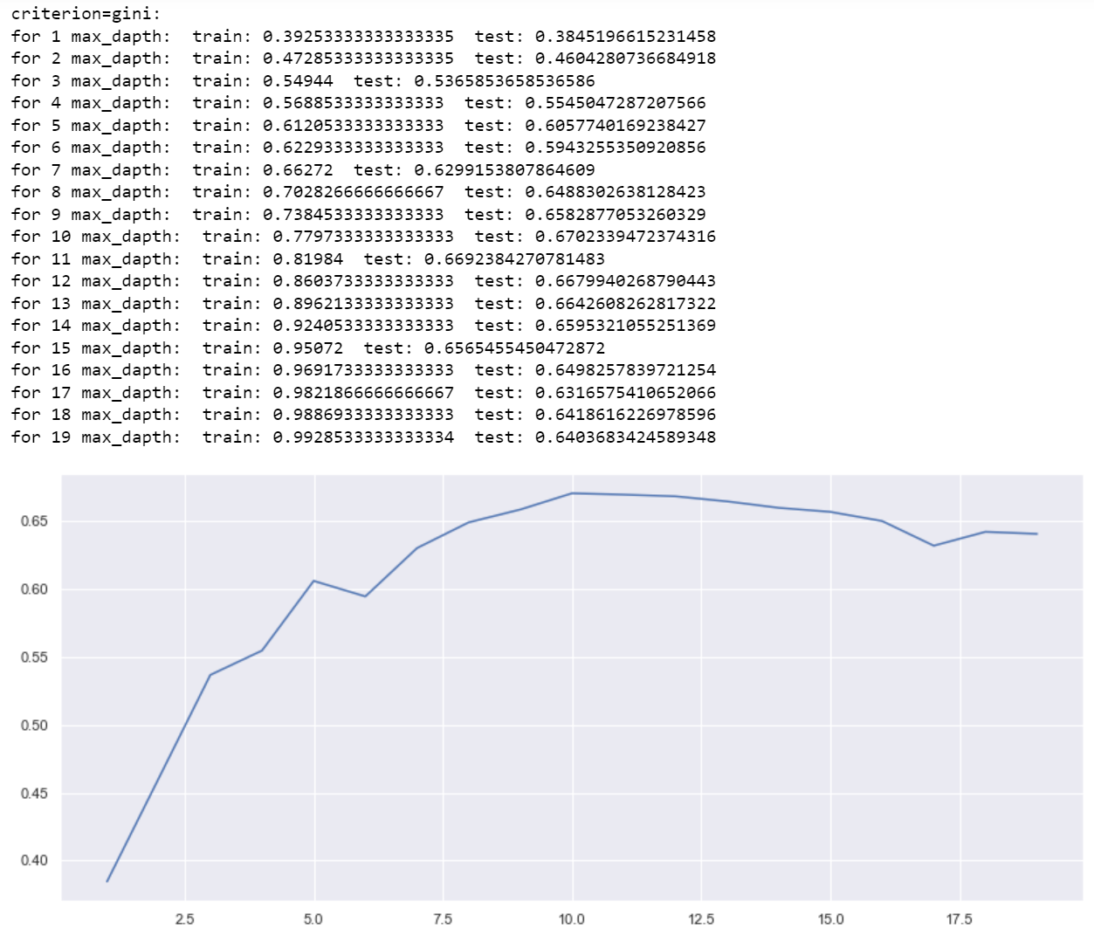
Model---Decision Tree
Decision Tree: Use the criterion function to classify different class
Criterion type: Gini impurity and Entropy.
Depth of the tree: 10 depths perform the best.
There are some over-fitting situations

Slide 7
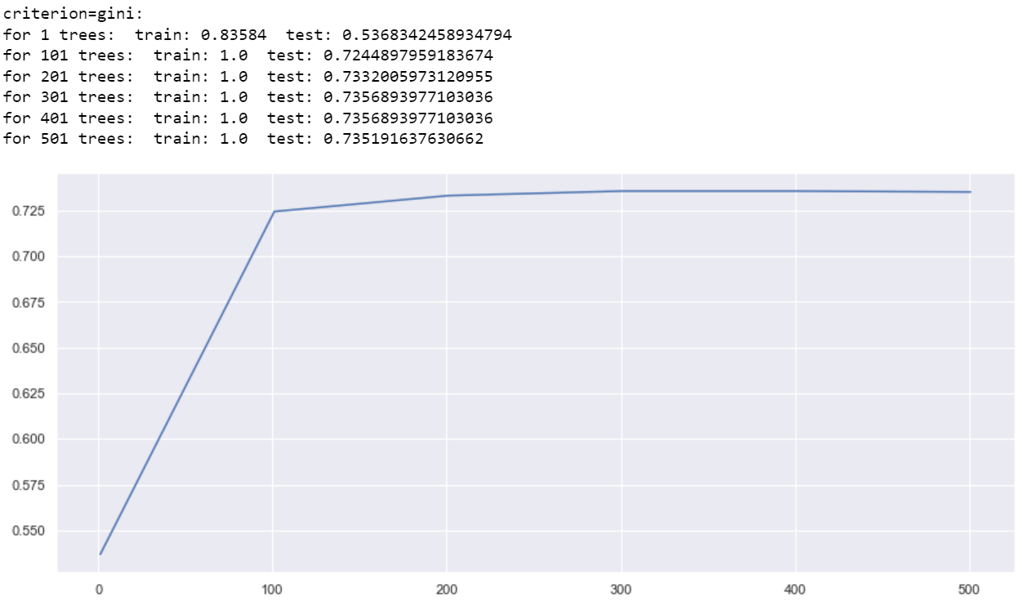
Model---Random Forest
Random Forest : Composed of several decision trees and vote for the final class
n_estimators : how many trees
As the trees number increase, the performance flatten out

Slide 8
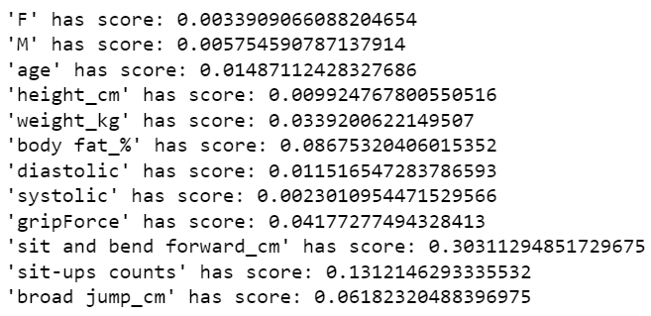
Feature Selection
Use the fs.SelectKBest() method to select the best features that relate to the result.
Score_func : fs.mutual_info_classif, calculate mutual information between variable and class.
Scores_ : we can check the score to determine which feature are most importment.

Slide 9
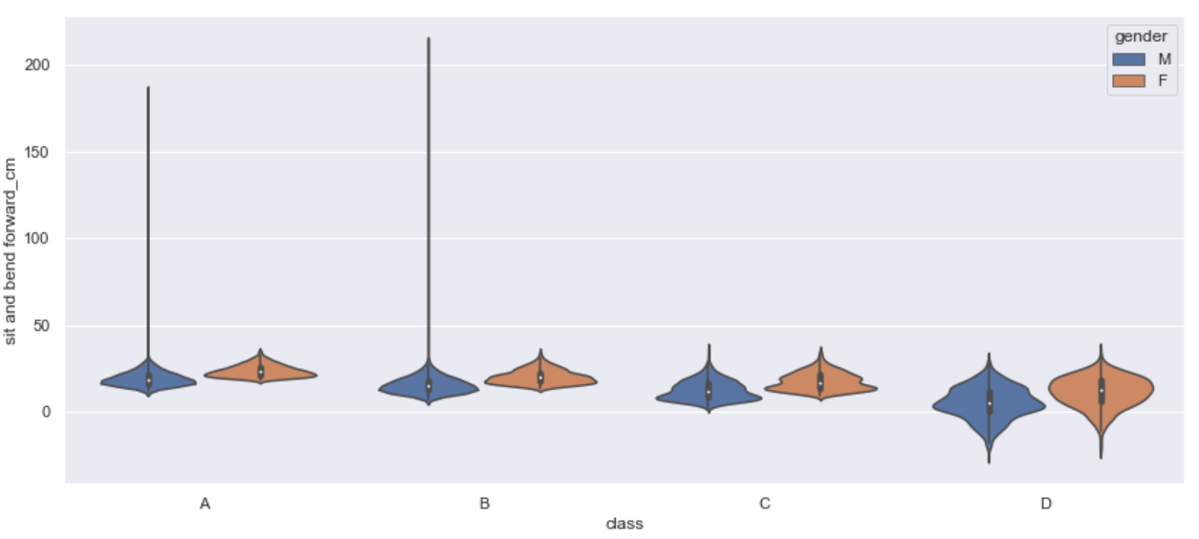
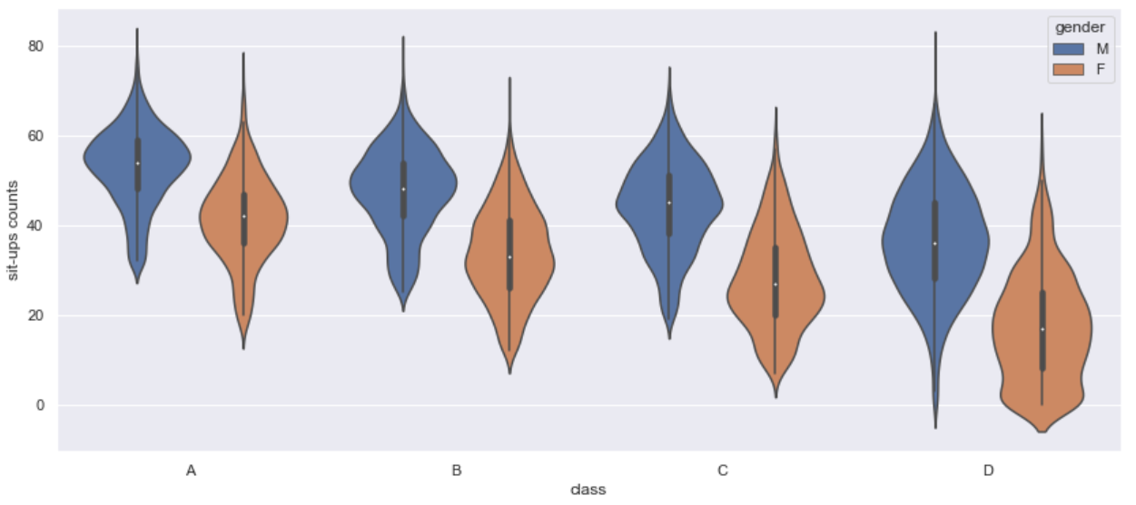
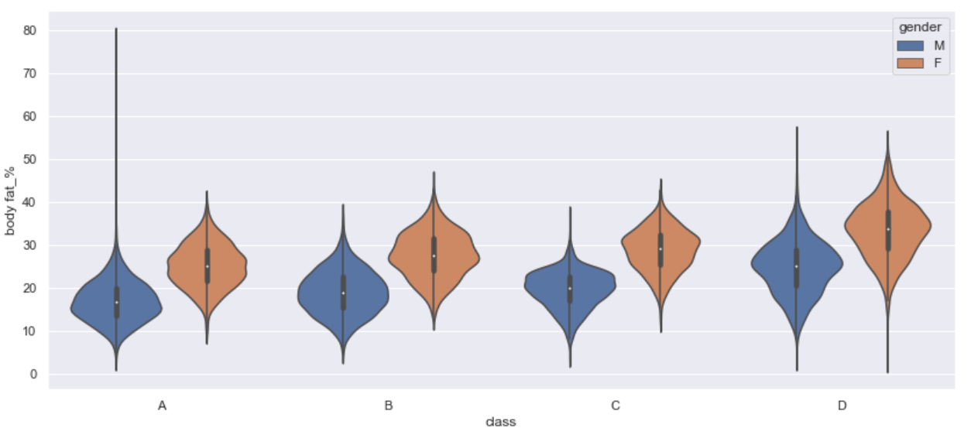
Feature Selection--- sit_band, sit_ups, body_fat, broad_jump

Slide 10
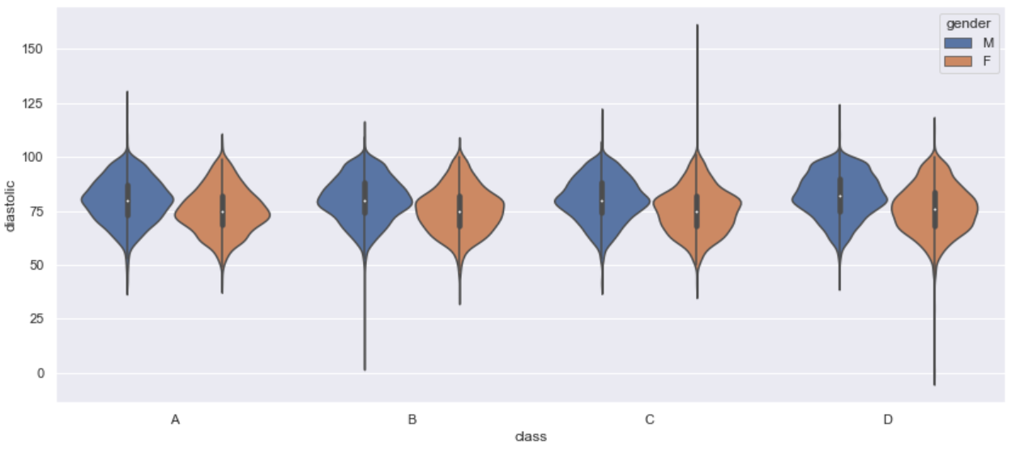
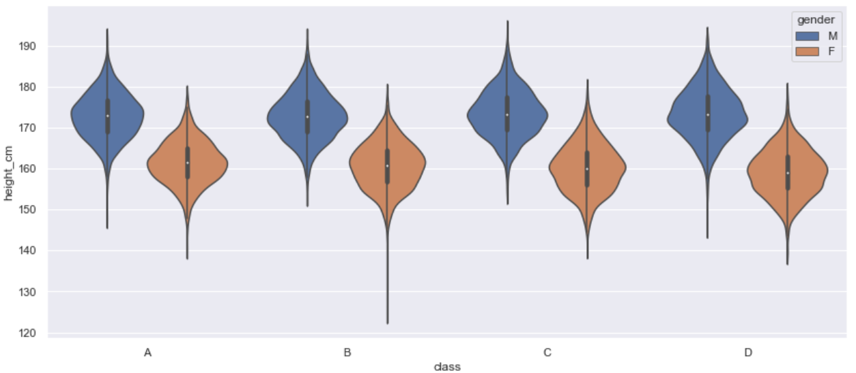
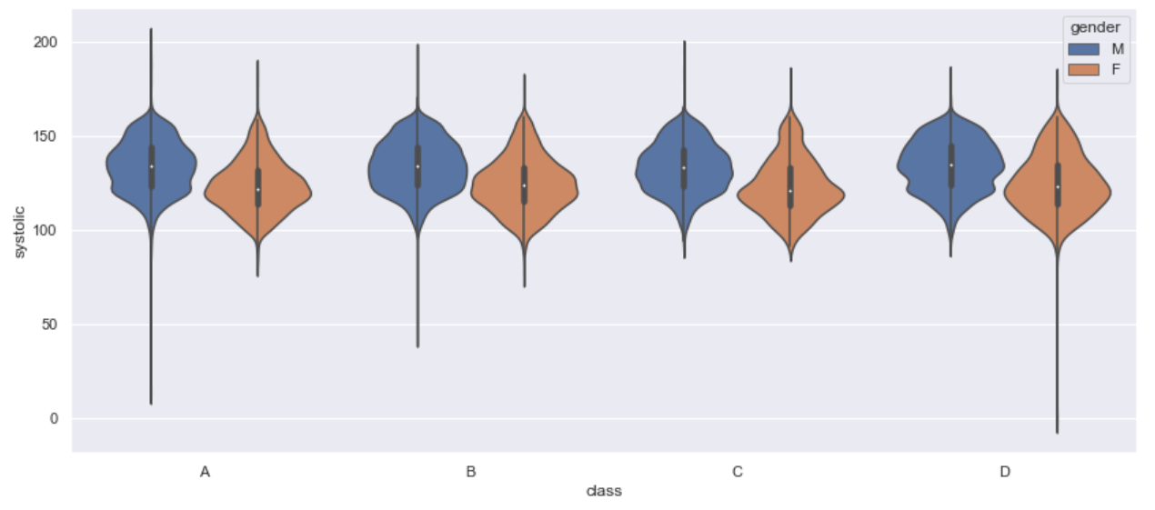
Feature Selection---diastolic, height, systolic

Slide 11

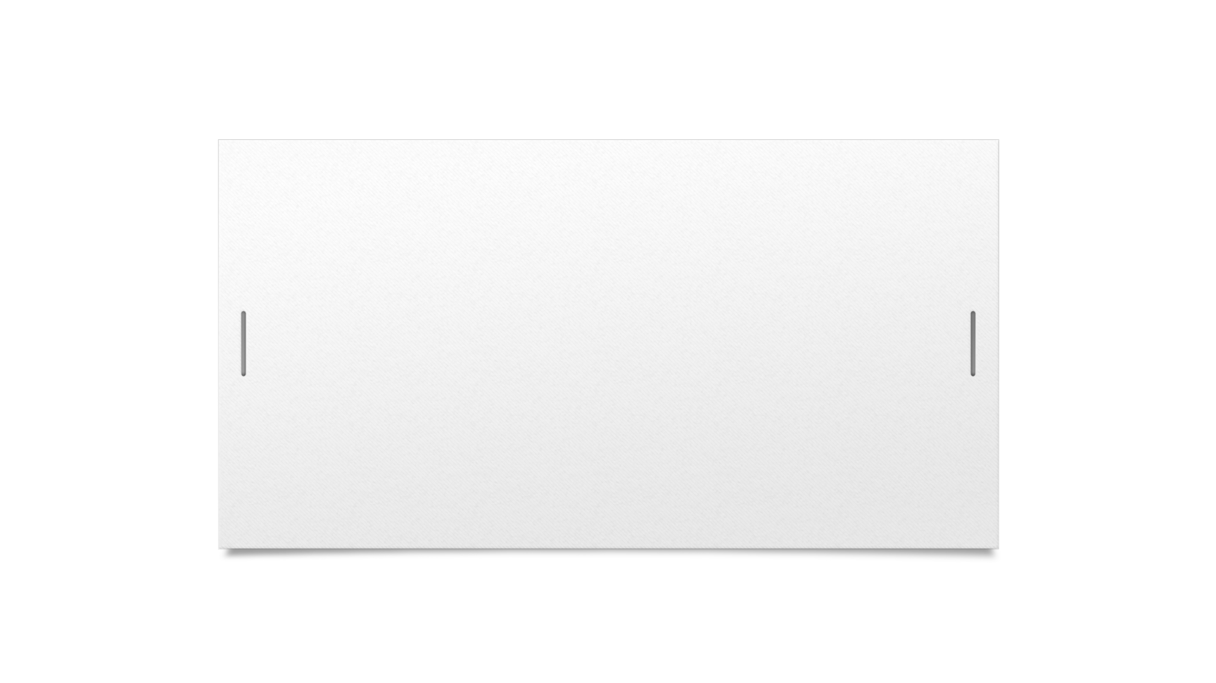

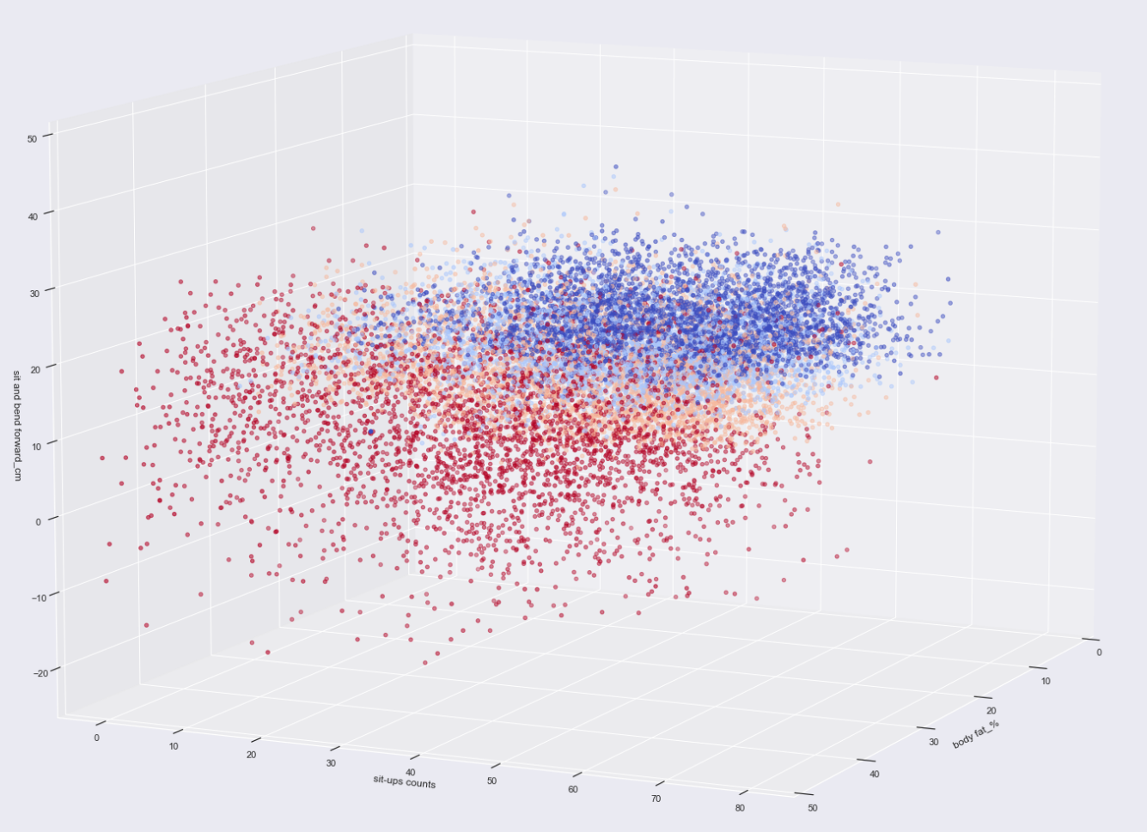


Correlation between top 3 features

Slide 12
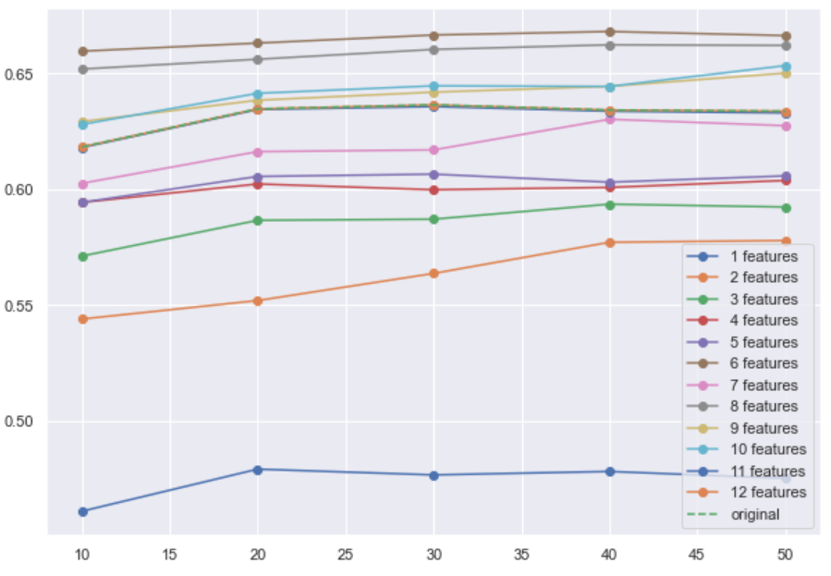
Feature Selection---KNN increase best
KNN model increase most under the feature selection.
The best numbers of neighbors in KNN slightly change.
Random Forest doesn't increase much but still hold the best performance.

Slide 13
Conclusion and Future Work
The model that had the best performance is Random Forest.
The model that increase most after the feature-selection is KNN.
The model had many noise data.
There are over-fitting problems in several model.
Expect to solve above two problems by more data engineering work.

Slide 14
Recent Work

Slide 15
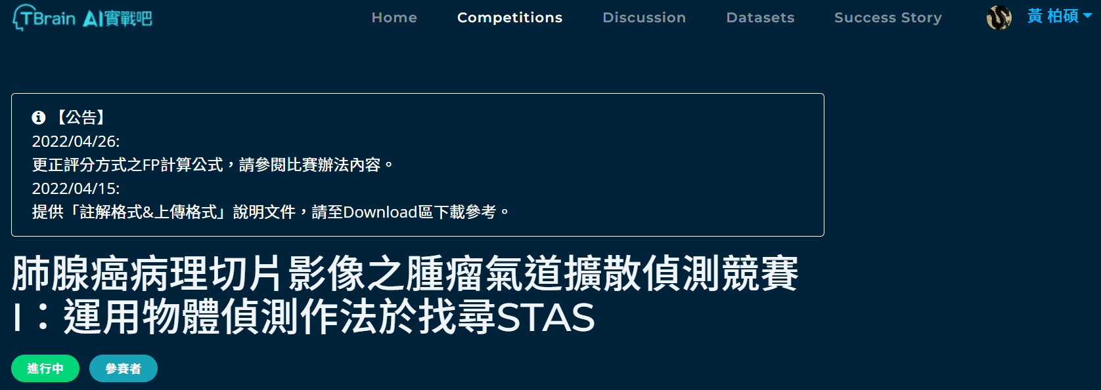
Detection of the Lung Adenocarcinoma
Use the Object Detection method on the slice photo to detect the lung adenocarinoma.
The dataset has 1061 images with labeled.xml for each photo.

Slide 16

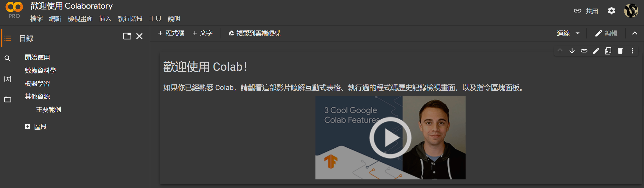
Yolov5 and Colab
YOLOv5 : A strong tool for object detection.
Google Colab : Online resource for gpu and writing python code.

Slide 17
Thanks!

